Slide 1
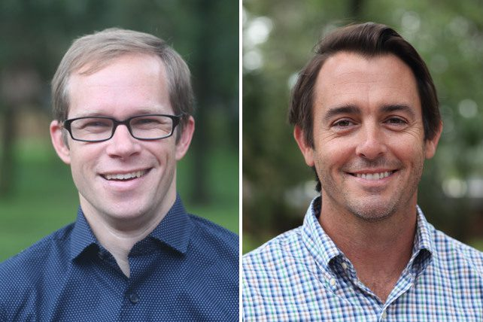
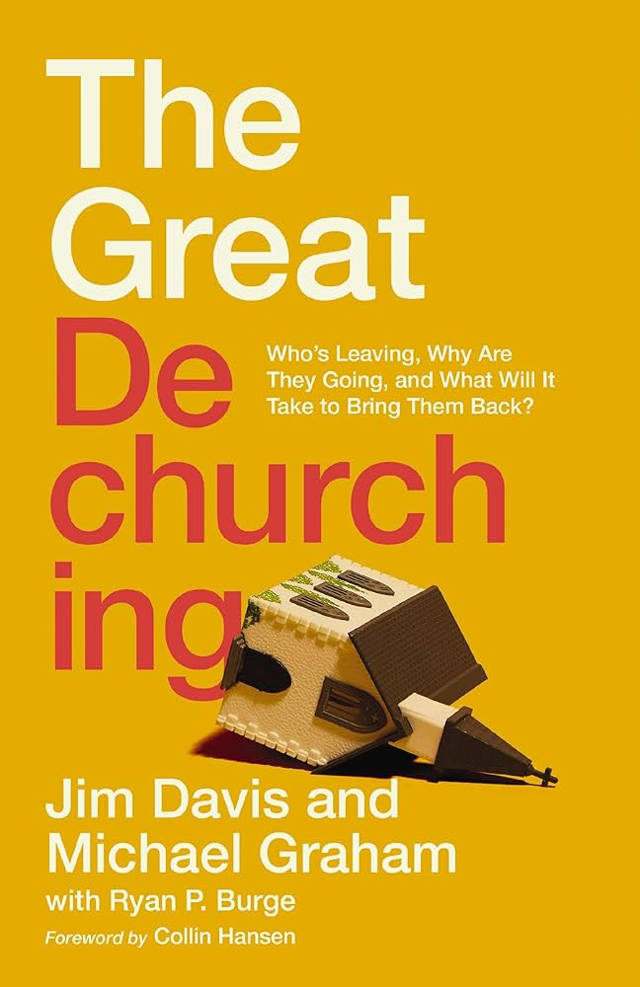
D E C O N S T R U C T I O N:
THE GREAT DECHURCHING
Jim Davis
Michael Graham
Facilitated By:
Bob and Karen Pourcho

Slide 2
W A R M U P
Think about someone in your life that used to actively attend church but is no longer doing so:
Why did they quit?

Slide 3
A G E N D A
Definitions
Who’s Leaving?
Why Are They Going?
What Will It Take To Bring Them Back?

Slide 4
THE GREAT DECHURCHING
Definitions

Slide 5
DEFINITIONS
RECONSTRUCTION
REFINEMENT
DECONSTRUCTION
REINFORCEMENT
OTHER CAUSES
DECHURCHING
DECONVERSION

Slide 6
Adult Church Attendance in the U.S.A.
The Attrition Rate is Rapidly Accelerating

Slide 7
THE GREAT DECHURCHING
WHO’S LEAVING?

Slide 8
DECHURCHED BY DENOMINATIONS
About 50 MILLION ADULTS ARE DECHURCHED

Slide 9
DECHURCHED EVANGELICALS
About 16,500,000 ADULTS ARE DECHURCHED EVANGELICALS

Slide 10
WHO ARE THEY
Mainstream: Look and act like people attending our church.
Cultural Christians: Apathetic about Jesus, with a hint of nostalgia. Few show evidence that they are really believers.
BIPOC: Black (76%), male (68%), indigenous, people of color. Highest level of income and education. Upwardly mobile.
EXvangelicals: People who have been deeply hurt by Christians or the church and have left intentionally.

Slide 11
THE GREAT DECHURCHING
WHY ARE THEY GOING?

Slide 12
MAINSTREAM
COVID -19 changed my habit
Divorce or major life change
Inconvenient / Other Priorities
Moved to a new community
No friends / I wasn’t loved

Slide 13
CULTURAL CHRISTIANS
Doubted God / Changed views
Sexual freedom / gender identity
Inconvenient / Other Priorities
No Friends / I wasn’t loved
Moved to a new community

Slide 14
BIPOC
Sexual freedom
My faith is not my own
Bad experience at church
Life got busy
No friends / I wasn’t loved

Slide 15
EXVANGELICALS
Inconvenient/Moved
Disagreed with the politics
Bad experience at church
I no longer believe
No friends / I wasn’t loved
Survey responses indicated significant pain.

Slide 16
DECONSTUCTION
The systematic pulling apart of one’s belief system for examination and analysis.
Wounded by the church or church members
Want sexual freedom, gender expression, or other sins
Political views
Street cred: Doubting is Hip!
This may lead to “DECONVERSION.”

Slide 17
THE GREAT DECHURCHING
HOW CAN WE REACH THEM?

Slide 18
REACHING MAINSTREAM
100% are willing to come back to church!
They are already open to attending a good church and may be casually searching for one
Need only one or two invitational nudges to return
They need a good experience when visiting

Slide 19
REACHING CULTURAL CHRISTIANS
50% are willing to come back to church.
Need an invitation rooted in a relationship
Open to a space like the Forecourt of the Temple
Need clear, in-depth teaching on the Bible and core Christian beliefs and doctrine

Slide 20
REACHING BIPOC
65% are willing to come back to church!
Need to see sincere relationships and community
Church needs to be sensitive and build bridges of love across ethnic divides
Need understanding and empathy for their vocational stress

Slide 21
EXVANGELICALS
0% are willing to come back to an evangelical church!
This is Spiritual Warfare: PRAY!
Many are hurt and depressed: Love, Listen, Lament
Many are lonely: Build a deep and caring friendship
Another church tradition may be a good option

Slide 22
THE GREAT DECHURCHING
REASONS TO HOPE

Slide 23
REASONS TO HOPE
51% of Dechurched think they will return to church.
Many Dechurched are true believers and have the Holy Spirit working in them
PRAY, LISTEN and LIVE out your faith
Relationships are POWERFUL, help them belong!
Strong Biblical teaching is crucial to keeping them!

Slide 24
REASONS TO HOPE
How to respond when a loved one Deconstructs.
T – Trust God
A – Affirm the Good
L – Love and Enjoy
L – Lament Alone
(and often)
Pray, don’t panic
Demonstrate an authentic faith
Love unconditionally and enjoy them
Be patient and endure
Trust in God and His word

Slide 25



R E S O U R C E S
As In Heaven Podcast
www.TheGospelCoalition.org
www.focusonthefamily.com

Slide 26
D I S C U S S I O N

